Slide 1
The Business Case for Hiring Military Veterans:
Strategies, Approaches and Best Practices
Nathan D. Ainspan, Ph.D.
Transition to Veterans Program Office (TVPO)
October 2016

Slide 2
Why Hire Veterans?
NOT patriotism or to thank the veteran
BUT as your talent strategy aligned with business needs
LINKED to business goals/your bottom line
INTEGRATED with diversity initiatives
Cleared, tested, and trained employees AT NO COST TO YOUR COMPANY

Slide 3
Competitive Advantage
  Rare
  Valuable
  Difficult to imitate or differentiate
Gain access to this pool of talent and know how to retain them before your competition.

Slide 4
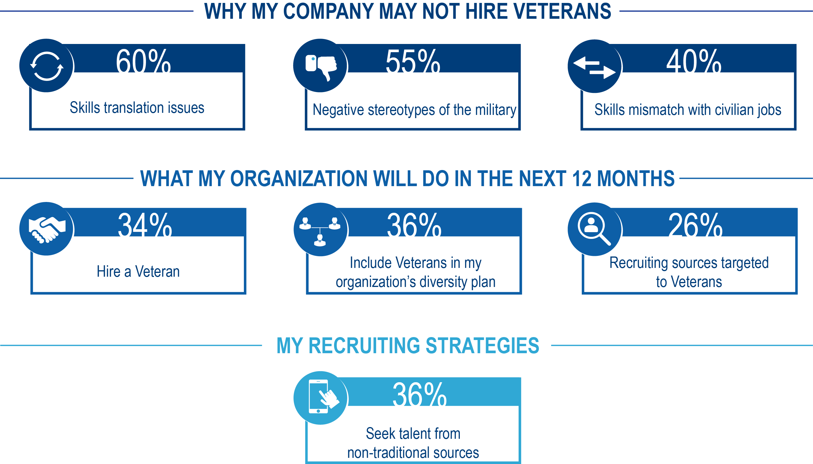
Competition Not Recruiting Veterans =
Your Competitive Advantage
Notes:
Why my company may not hire veterans:
60% of skills translation issues.
55% negative stereotypes of the military
405 skills mismatch with civilian jobs
Center for New American Security survey (2012)
What my organization will do in the next 12 months
34% will hire a veteran
36% will include veterans the my organization’s diversity plan
26% will use recruiting sources targeted to veterans
SHRM/Cornell University Recruiting Veterans with Disabilities survey (2011)
My recruiting strategies
36% will seek talent from non-traditional sources (e.g. veterans, retirees)
SHRM New Talent Landscape survey (2016)

Slide 5
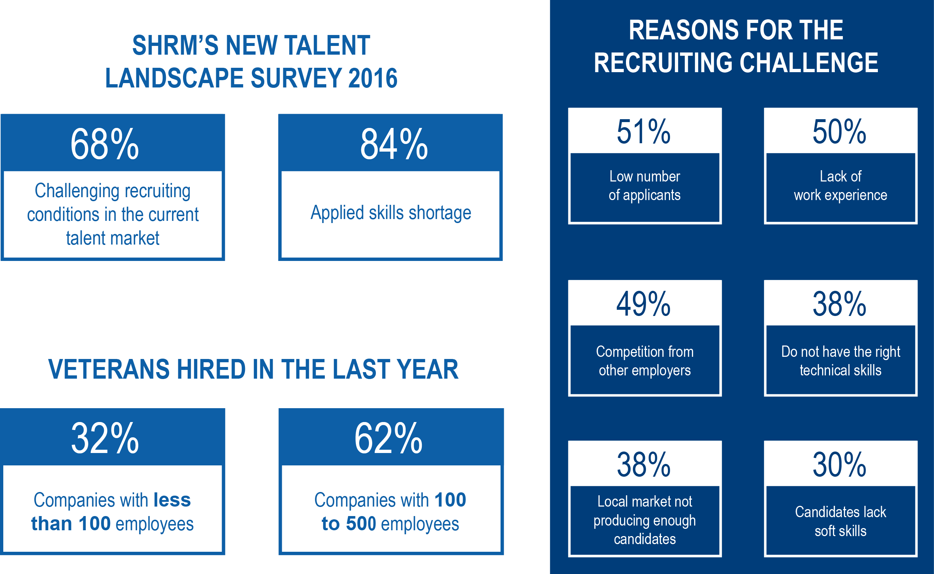
The Recruiting Landscape
Notes:
68% of HR professionals are facing challenging recruiting conditions in the current talent market.
84% see an applied skills shortage.
Reasons for the recruiting challenge:
Low number of applicants – 51%
Lack of work experience – 50%
Competition from other employers – 49%
Candidates do not have the right technical skills – 38%
Local market not producing enough candidates – 38%
Candidates lack soft skills – 30%
Only 32% of companies with less than 100 employees hired veterans in the last year (62% of companies with 100 to 500 employees)

Slide 6
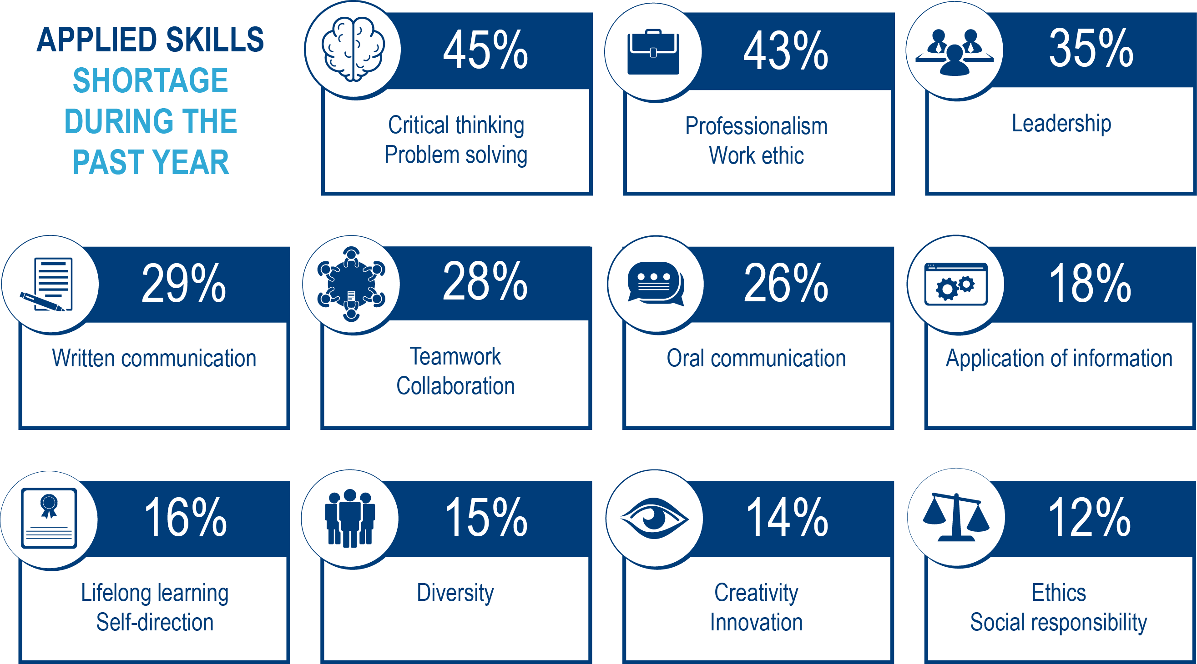
Skills Employers Desire and Employees Lack
Notes:
Applied skills shortage during the past year:
Critical thinking/problem solving – 45%
Professionalism/Work Ethic – 43%
Leadership – 35%
Written communication – 29%
Teamwork/collaboration – 28%
Oral communication – 26%
Application of information – 18%
Lifelong learning/self-direction 16%
Diversity – 15%
Creativity/innovation / 14%
Ethics/social responsibility – 12%
SHRM’s New Talent Landscape Survey (2016)

Slide 7
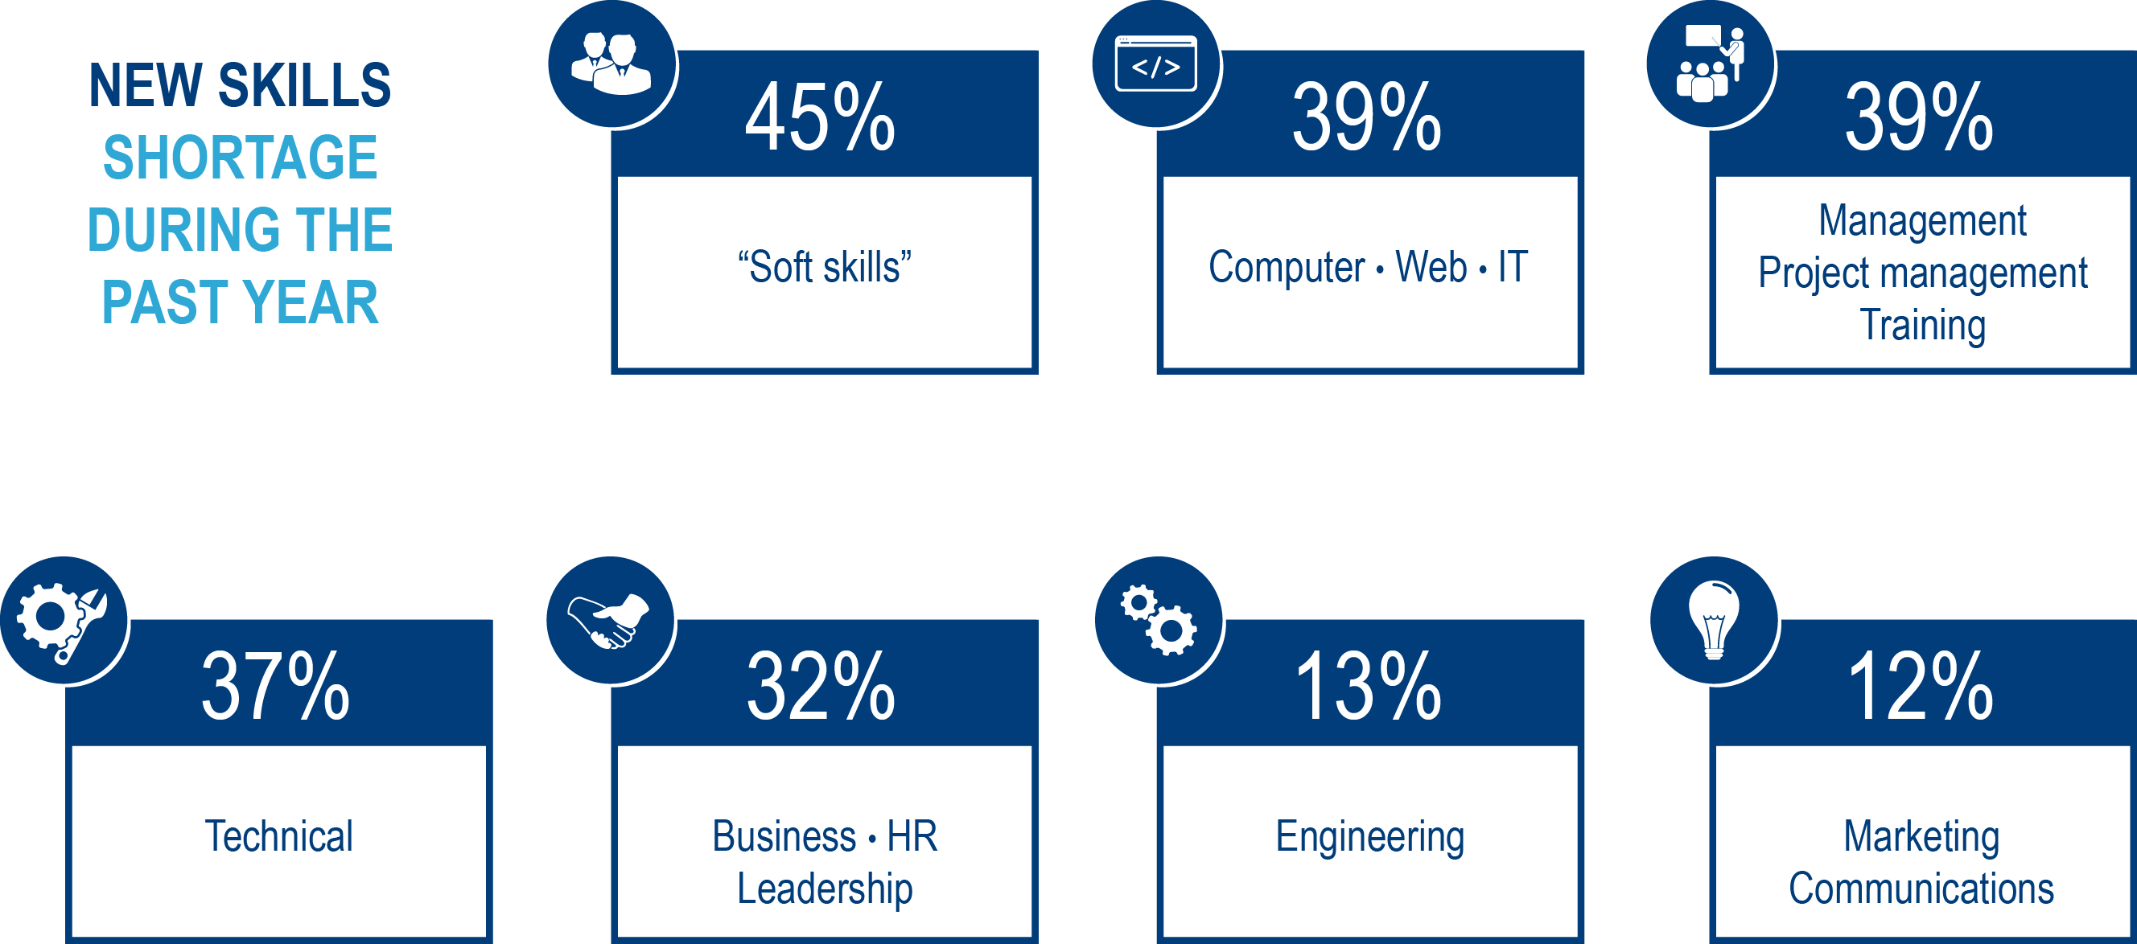
Skills Employers Desire and Employees Lack
Notes:
New skills shortage during the past year:
“Soft skills” (problem-solving, interpersonal skills, communication, teamwork, leadership) – 45%
Computer/web/IT – 39%
Management/project management/training – 39%
Technical – 37%
Business/HR/leadership – 32%
Engineering – 13%
Marketing/communications – 12%
SHRM’s New Talent Landscape Survey (2016)

Slide 8
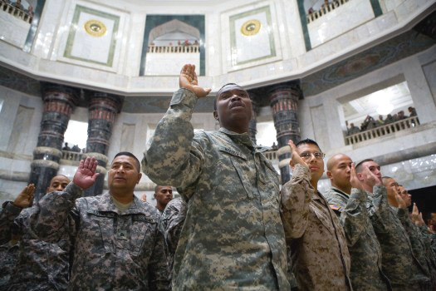
Caution About Generalizing
Notes:
Military is one of the most diverse organizations in the nation.
Not all veterans are identical – or will do well in your company.
Treat like a graduate school degree or SPHR or other certification.
That being said – self-select into military, engage in the culture, receive training and development opportunities, and promoted on specific traits.

Slide 9

Veteran Status = Certification/License/Diploma
Notes:
Visual –it’s a competitive advantage – 1) rare, 2) valuable, 3) difficult to imitate and differentiate

Slide 10


Advanced Beyond Their Civilian Peers

Slide 11

Integrity
Notes:
Picture of an IED inspector, handling a weapon or missile

Slide 12





Skills Employers Desire and Employees Lack
RAND’s Essential Skills Translation Tools

Slide 13

Veterans’ Essential Skills
Handling Work Stress
Notes:
Picture of an IED inspector, handling a weapon or missile

Slide 14

Veterans’ Essential Skills
Being Dependable and Reliable
Notes:
A group at early morning muster?

Slide 15

Veterans’ Essential Skills
Conscientiousness and Attention to Detail
Notes:
Working on a complex bit of technoolgy?

Slide 16

Veterans’ Essential Skills
Interpersonal Skills
Notes:
Photo of service members interacting

Slide 17

Veterans’ Essential Skills
Teamwork and Team-Building

Slide 18
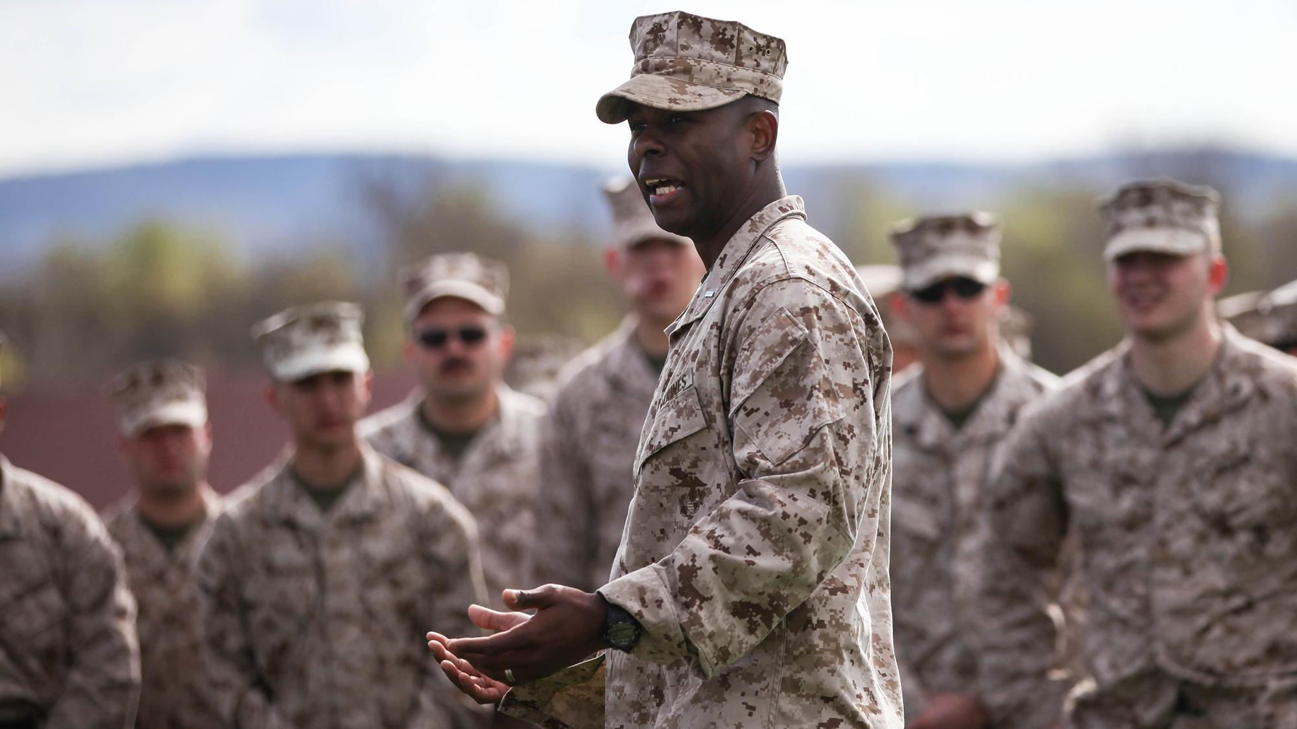
Veterans’ Essential Skills
Leading, Motivating, and Inspiring Others

Slide 19

Veterans’ Essential Skills
Oral Communication

Slide 20
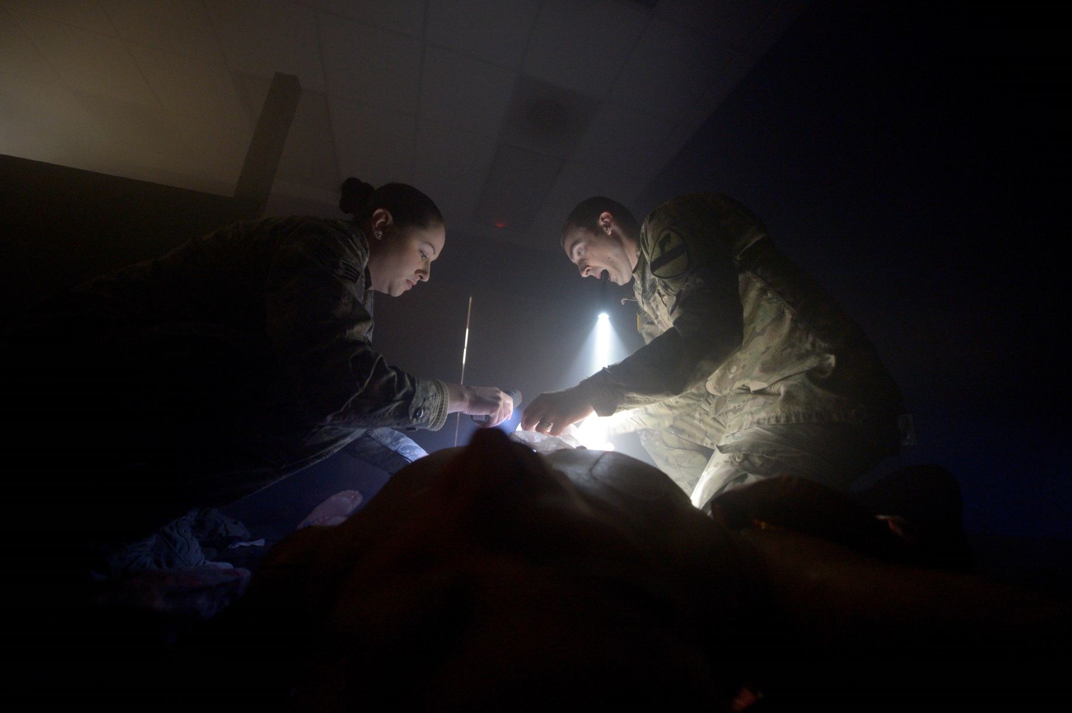
Veterans’ Essential Skills
Decision-Making/Decisiveness

Slide 21
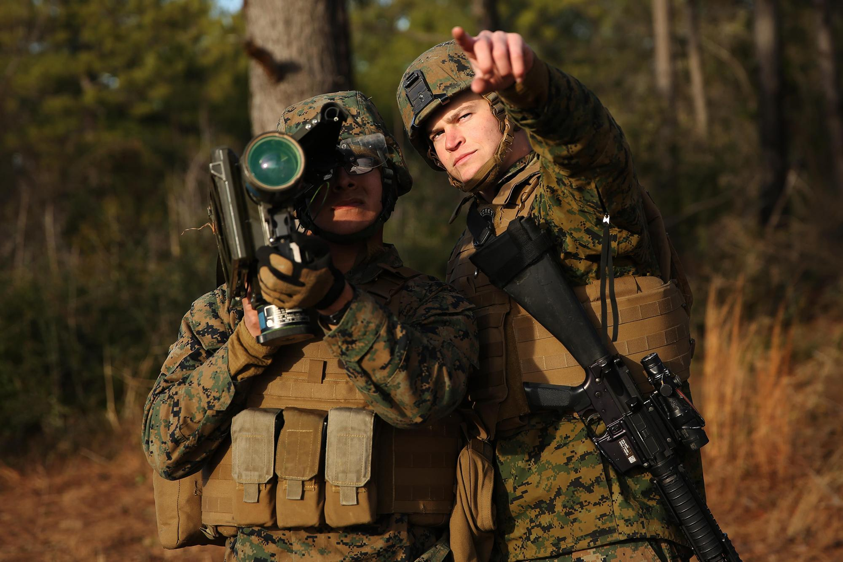
Veterans’ Essential Skills
Training Others

Slide 22

Veterans’ Essential Skills
Managing and Supervising the Work of Others

Slide 23

Veterans’ Essential Skills
Critical Thinking

Slide 24
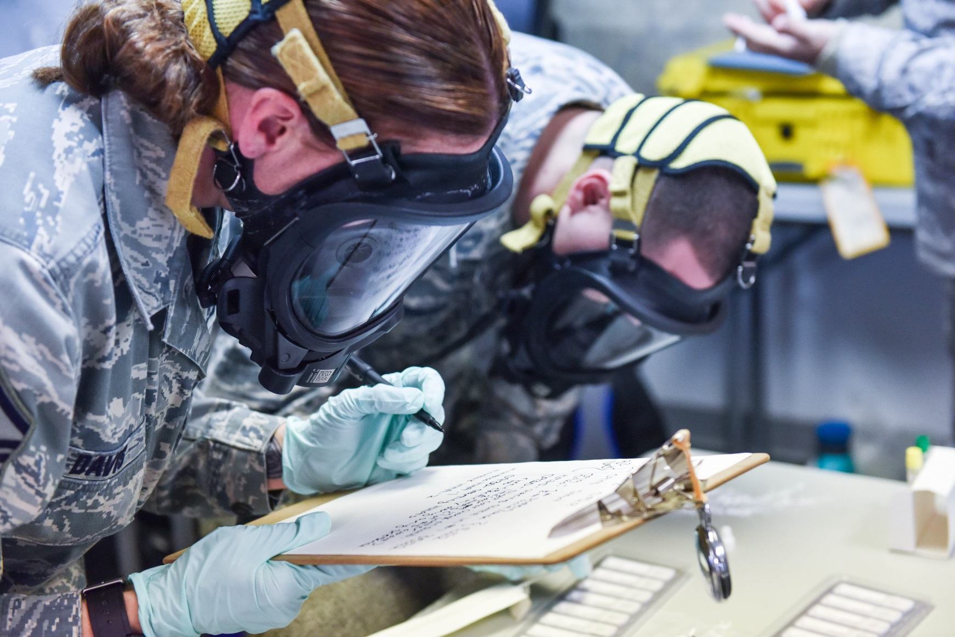
Veterans’ Essential Skills
Written Communication

Slide 25

Veterans’ Essential Skills
Project Planning

Slide 26
Other Traits
Highly Qualified – Strict Entry Criteria, Drug/Background Tests, and Security Clearances
Advanced Technical Skills
Trained, Trainable and Can Train Others
Resilient
Entrepreneurial
Trust
Comfortable and Adapt at Discontinuous Environments

Slide 27
Resources for Recruiting Veterans
Contact your Local Base Transition Office
American Job Centers
  http://www.careeronestop.org/Site/businesses.aspx
Hiring Our Heroes (US Chamber of Commerce)
  https://www.uschamberfoundation.org/hiring-our-heroes
DoD’s SkillBridge program
  www.DoDSkillBridge.com
DoD’s Transition Assistance Program
  www.dodtap.mil
VA’s Veteran Employment Toolkit
  http://www.va.gov/VETSINWORKPLACE/mil_structure.asp

Slide 28
Resources for Recruiting Veterans
Employer Support for the Guard and Reserve
  www.esgr.mil
Tax benefits from state and local government
Check your industry for initiatives
Check out state/business/military partnerships

Slide 29
Publications
Guide to Leading Policies, Practices, and Resources
The Business Case for Hiring a Veteran: Beyond the Clichés
Revisiting the Business Case for Hiring a Veteran
  Available from the Institute for Veterans and Military Families
  http://vets.syr.edu/employment/employer-resources
What Veterans Bring to Civilian Workplaces by the RAND Corporation (Essential Non-Technical Skills)
  http://www.rand.org/pubs/tools/TL160.html
Hiring Our Heroes’ Employer Roadmap
  http://employerroadmap.org/
Talent Development’s Supporting and Developing Veterans
  http://www.td.org/Publications/Magazines/TD/TD-Archive/2016/09/TD-Supplement-Supporting-and-Developing-Veterans
VA’s Guide to Hiring Veterans
  http://www.employerroadmap.org/download/va-guide-to-hiring-veterans
The White House’s Guide to Hiring Veterans
  https://www.whitehouse.gov/sites/default/files/docs/white_house_business_council_-_guide_to_hiring_veterans_0.pdf

Slide 30
Nathan D. Ainspan, Ph.D.
Research Psychologist
Transition to Veterans Program Office
Department of Defense
nathan.d.ainspan.civ@mail.mil

